Slide 1

HS 2015
Current Trends in Distributed Systems
Midterm presentation
Group:
Patrick Zumsteg
Simon Wallny
Philipp Oldenburg

Slide 2
Structure
Setup
Sensor Server
DB Manager
Classification
HS 2015
Current Trends in Distributed Systems – Midterm presentation
<Nummer>

Slide 3

Setup
Storm Cluster
SV1
S1
Sensor
Server
DB-
Man
S2
SV2
HS 2015
Current Trends in Distributed Systems – Midterm presentation
<Nummer>

Slide 4

Sensor Server
Sensor Server:
  Running on Raspberry Pi 1
  Written in Python
    Using sensor library: https://github.com/adafruit/Adafruit_Python_BMP
  Java Client
    Simple protocol
HS 2015
Current Trends in Distributed Systems – Midterm presentation
<Nummer>

Slide 5
Logging our data
DBMan: Handles all traffic to and from the database
BASIC FUNCTIONALITY
  Collects data from sensor servers
  For now: gets other data from weather service
    Like: humidity, current weather
  Stores data sets in DB
  Is connected to Spouts, provides data to them
HS 2015
Current Trends in Distributed Systems – Midterm presentation
<Nummer>

Slide 6
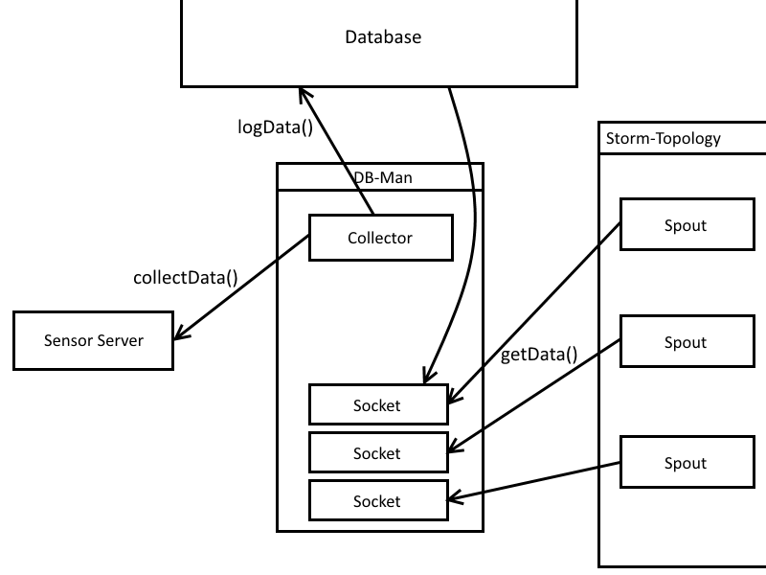
Logging our data
HS 2015
Current Trends in Distributed Systems – Midterm presentation
<Nummer>

Slide 7
Why bother with a database?
Storm may be hard to kill, but:
  Proper training of classifier takes time
  Topology would have to run constantly
  New classifier forces restart
HS 2015
Current Trends in Distributed Systems – Midterm presentation
<Nummer>

Slide 8
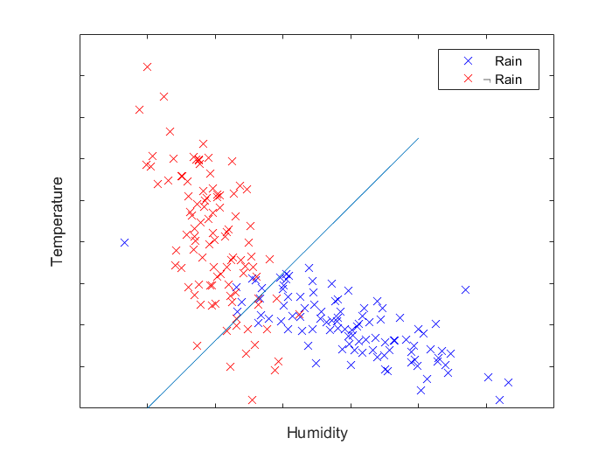
Classification
Linear Classifiers
  Naive Bayes
  SVM
4-dimensional feature space
  Temperature
  Wind speed
  Air pressure
  Humidity
HS 2015
Current Trends in Distributed Systems – Midterm presentation
<Nummer>

